Slide 1
Explainable
Recommendation
Systems
By
Vaibhav Gera - 24M0749
Yash Sarang - 24M2160
Lakhan Pal - 24M2138

Slide 2
Introduction
Different Kinds of Explanations
An explainable recommendation model provides personalized suggestions while transparently articulating the reasoning behind each recommendation to enhance user trust and understanding.
Explainable recommendation models can be model intrinsic or model agnostic.
Basic techniques for recommendation models are:
Collaborative Filtering
Content Based Filtering
Collaborative Filtering is Less Intuitive. LF / KG based models are similar to Collaborative or CB FIltering in nature.
Advanced techniques for recommendation models include:
Deep Learning based
Reinforcement Learning based
Latent factors or Knowledge graph based
Relevant User:
Example: "Highly rated by similar users."
Sentence:
Example: "You may like this because others did."
Reasoning Rules: Example: "You liked [X]; [X] is similar to [Y]."
Ratings Histogram (User-Based):
Visual of ratings by similar users.
Radar Chart:
Compares item features to user preferences.

Slide 3
Hidden Factor and Topic model (HFT)
Extract latent variables or "hidden factors" driving market behavior.
Factors are inferred from observable data like user reviews in our case.
LDA topics are learned from the reviews.
Links each dimension of the latent vector with a dimension of the LDA topic distribution vector.
User Item Matrix is then factorized using techniques like SVD.
The goal of SVD is to decompose A into three matrices that
reveal its latent factors:
A=UΣVT
Explainability in HFTs Challenge:
Latent factors are abstract and lack direct interpretability.
Solutions for Explainability:
Feature Mapping:
Map latent factors to interpretable features (e.g., genres, price, quality).
Factor Labeling:
Manually assign meaning to factors using domain knowledge.
Example-Based Explanation:
Show similar items/users contributing to the recommendation.
Graphical Representation:
Visualize latent dimensions as clusters or ratings distribution.

Slide 4
Collaborative Filtering (CF) Approach
Approach: Recommends items based on user-user or item-item similarities.
Type Used:
User-based CF: This implementation identifies similar users (based on their rating patterns) and recommends items that those similar users rated highly.
Explainability: The recommendations are explainable by showing which users contributed to the score of a recommendation (e.g., "because similar users rated it highly").
Key Components
Data:
The input is a user-item matrix (user_item_matrix), where rows represent users, columns represent items, and values represent ratings.
User Similarity Matrix (user_similarity):
Precomputed similarity matrix where user_similarity[i][j] gives the similarity score between user i and user j.
This could be computed using methods like cosine similarity, Pearson correlation, or other distance measures.
Recommendation Score Calculation
Ranking and Explanation:
Items are ranked by their computed scores.
Explanations are provided by listing the similar users who influenced the recommendation:

Slide 5
Content-based approach
Approach: This type of model recommends items by comparing the content (features) of the items using information such as genres, descriptions, or any other metadata related to the items.
1. TF-IDF Vectorization:
Text processing where features are converted into a numerical format using TF-IDF (Term Frequency-Inverse Document Frequency) vectorization. This method transforms text into a meaningful representation of numbers which is used to compare entities(movies in this case) quantitatively. TF-IDF highlights the importance of words (genres, in this case) that are frequent in a document but not across documents.
2. Cosine Similarity:
Once entities are vectorized into TF-IDF vectors, cosine similarity is calculated between all pairs. This similarity measure helps determine how similar two movies are based on their genres by calculating the cosine of the angle between their vector representations in high-dimensional space. A cosine similarity score of 1 means the movies are very similar, while a score of 0 means they are completely different.
3. Recommendation Function:
The recommendation function sorts movies based on their similarity scores relative to a chosen movie and outputs the top movies that are most similar. This function is the core of the recommendation system, allowing users to find movies similar to those they like. 4. Explanation of Recommendations:
To make the recommendations explainable, the system also includes a mechanism to outline why each movie is recommended. It does this by highlighting the common genres shared with the movie of interest, alongside the similarity scores. This adds a layer of transparency, helping users understand why certain movies are suggested.

Slide 6
Explainable Hybrid Recommendation System
Key Points:
Objective: Recommending movies to users based on a hybrid of:
Collaborative Filtering: Predicts ratings using user-item interaction history.
Content-Based Filtering: Leverages movie genres and tags to calculate similarity.
Explainability Approaches:
Hybrid Score Breakdown: Highlights contributions of Collaborative and Content-Based Filtering.
Decision Tree Rules: Explains recommendations using interpretable rules based on movie features.
A flowchart showing:
User preferences → Collaborative Filtering (SVD) → Hybrid Score
Movie metadata → Content Similarity → Hybrid Score
Training the Tree:
Input: Movie features (genres, tags, etc.) and user feedback (liked/not liked).
Output: Interpretable rules that predict whether a user will like a movie.
Interpretable Output:
Movies with low "Drama" and moderate "Animation" tags are classified as "liked." so movies with these content align with users preferences
Example Decision Tree Rules: Fantastic Mr. Fox |--- drama <= 0.50
| |--- sci <= 1.50
| | |--- animation > 0.50
| | | |--- class: Liked

Slide 7
Other Explored Approaches include:
Reinforcement Learning Approach
Deep Learning Approach
LLM Integration Approaches
Latent Factors / Knowledge Graphs based approaches

Slide 8
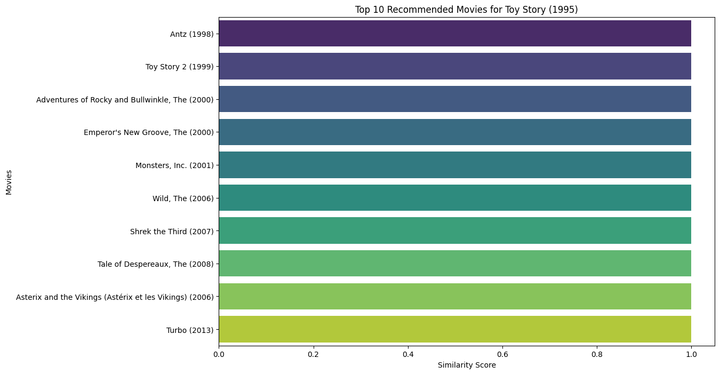
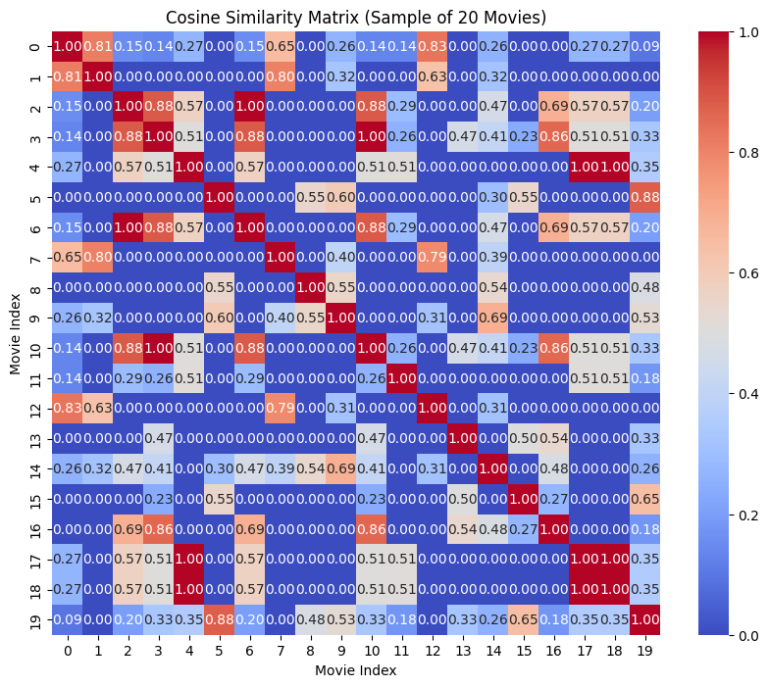
Sample Outputs - Content Based Approach

Slide 9
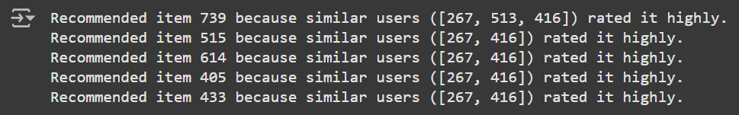
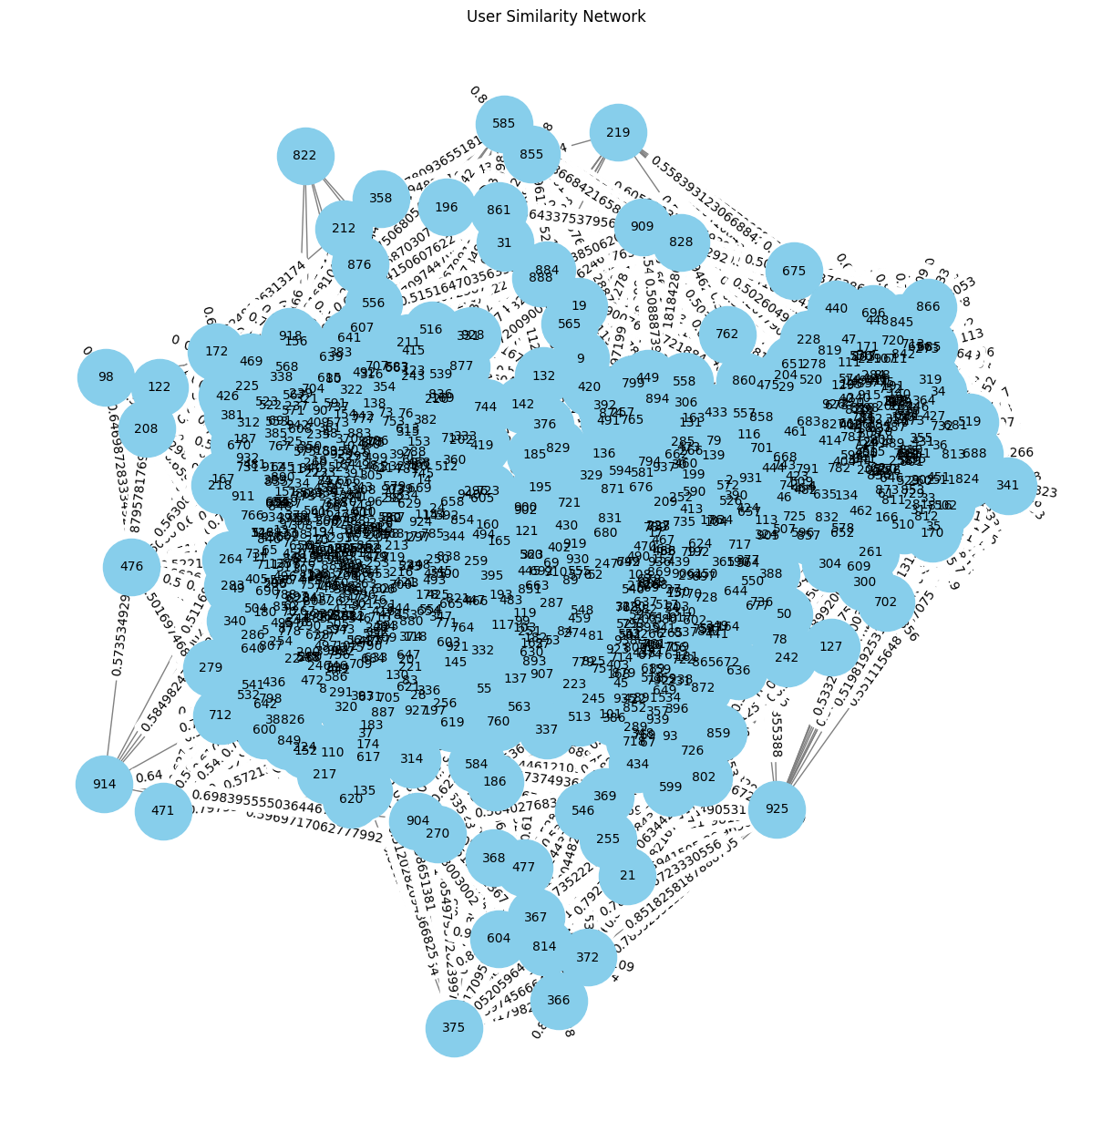
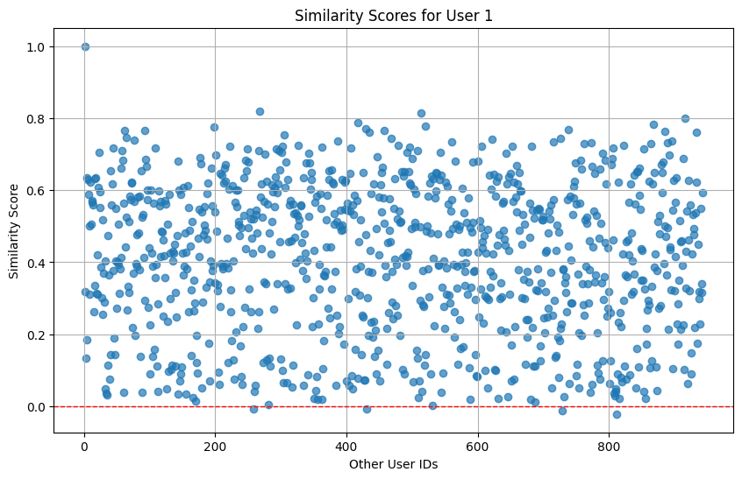
Sample Outputs - Collaborative Based Approach

